Slide 1
Apologetics… Defending the Faith
Scripture in Support of Our Catholic Beliefs
Lesson 3 – Mary, or Where is That in the Bible?
Notes:
We’ve gone over the definition of apologetics and why we should all endeavor to be at least somewhat proficient at it. Then we covered the misunderstandings between the Protestant and Catholic versions lf the ten commandments, and finally the issues abut idolatry and the actual teachings of the Church and the practices of Catholics.

Slide 2
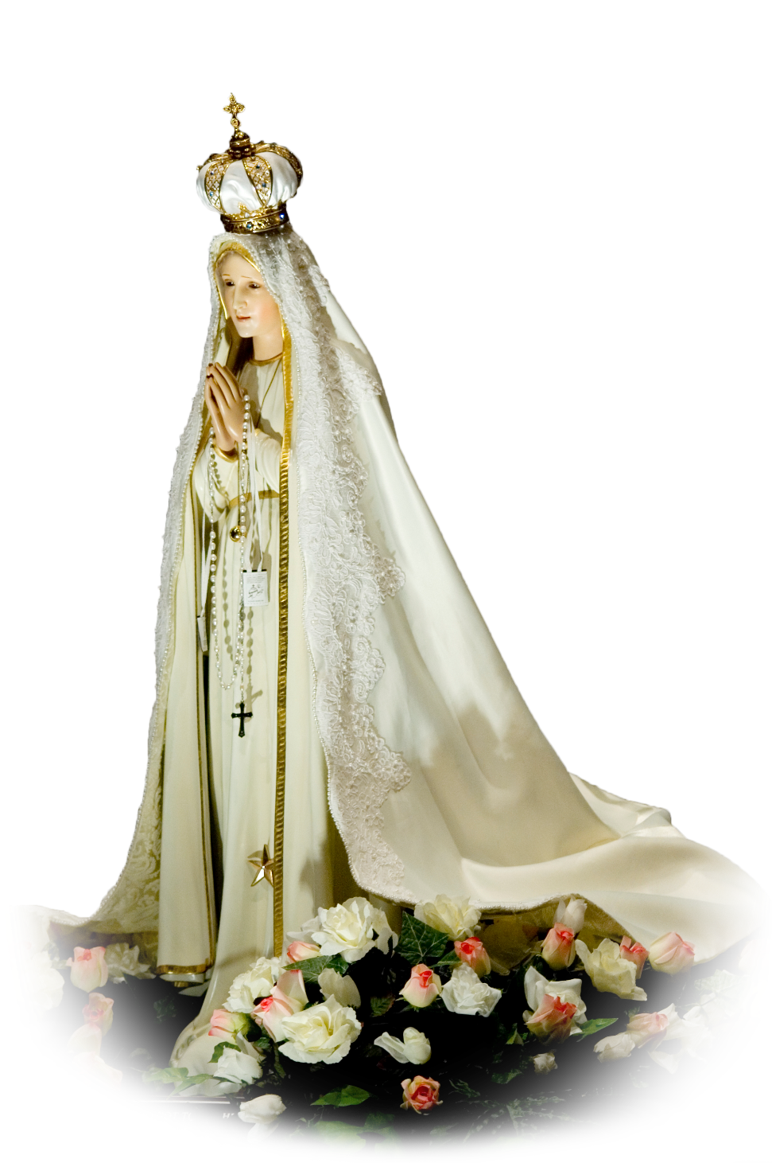
A Common Misunderstanding
Our Beliefs Concerning Mary
Notes:
Very much related to the last session on idolatry is the notion of worshipping Mary.
This is one of the sticking points with Protestants: That Catholics build idols of Mary and worship her.

Slide 3
Why Apologetics? Review…
Jesus teaches us…
“Go therefore and make disciples of all the nations, baptizing them in the name of the Father and the Son and the Holy Spirit”
Matthew 28:19
Notes:
So let’s review a couple of key apologetic points:
First, Jesus tells us to go and make disciples of all the nations.

Slide 4
Why Apologetics? Review…
Paul teaches us…
“…but sanctify Christ as Lord in your hearts. Always be ready to give an explanation to anyone who asks you for a reason for your hope,”
1 Peter 3:15
Notes:
Paul instructed us to defend and explain our faith in the scriptures…
He writes in his first letter to Peter to always be ready to defend the faith…

Slide 5
Be Armed and Ready
Always keep in mind:
NOTHING in the teachings of the Catholic Church contradicts ANYTHING in the Bible.
NOTHING in the Bible contradicts ANY of the teachings of the Catholic Church.
Notes:
REMEMBER THIS!
When you understand this, you cannot be beaten.
We are backed by the full authority of the scriptures AND the Church which is “The Pillar and Foundation of the TRUTH

Slide 6
Be Armed and Ready
The Church… “which is the church of the living God, the pillar and foundation of truth.”
1 Timothy 3:15
Notes:
REMEMBER THIS!
When you understand this, you cannot be beaten.
We are backed by the full authority of the scriptures AND the Church which is “The Pillar and Foundation of the TRUTH

Slide 7
Be Armed and Ready, but Willing to Retreat
But if you don’t know the answer to a question,
Never be afraid to say:
?
Notes:
We don’t read the bible enough in that sense, although in another lesion I’ll go over just how much we really do read the Bible.
And that’s a real surprise for most Protestants. (for instance, there are over 227 scripture references in the mass alone.)
DO NOT BE AFRAID TO SAY I DON’T KNOW!
Then say, “But I’ll find out and get back to you.”

Slide 8
Be Armed and Ready, but Willing to Retreat
But if you don’t know the answer to a question,
Never be afraid to say:
“I don’t know, but I’ll find
out and get back to you.”
Notes:
We don’t read the bible enough in that sense, although in another lesion I’ll go over just how much we really do read the Bible.
And that’s a real surprise for most Protestants. (for instance, there are over 227 scripture references in the mass alone.)
DO NOT BE AFRAID TO SAY I DON’T KNOW!
Then say, “But I’ll find out and get back to you.”

Slide 9
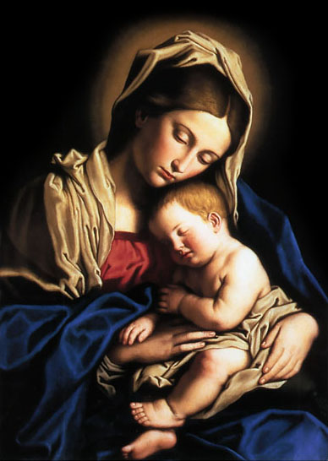
The Catholic Teachings About Mary
Perpetual Virginity
The Immaculate Conception
The Assumption of Mary
Mary Queen of Heaven
As Ark of the New Covenant
Notes:
We Catholics put a lot of emphasis on honoring Mary. While all Christians acknowledge her as the Mother of Jesus, many non Catholic Christians discount the emphasis that Catholics put on her and even deride Catholics for worshipping her as a deity.

Slide 10
The Catholic Teachings About Mary
Perpetual Virginity
The Immaculate Conception
Notes:
This week we’ll talk about Mary’s perpetual virginity, and the Immaculate conception. and.
We’ll cover Mary’s assumption into Heaven, May as Queen of heaven and Mary as the ark of the new covenant next time.

Slide 11
The Perpetual Virginity of Mary
The Catholic Church teaches us that Mary was a virgin at the conception of Jesus (Uncontested Biblical fact) and remained a virgin throughout her life and until the end of time.
Notes:
The common objection to Mary’s perpetual virginity is the frequent mention of the brothers and sisters of Jesus.

Slide 12
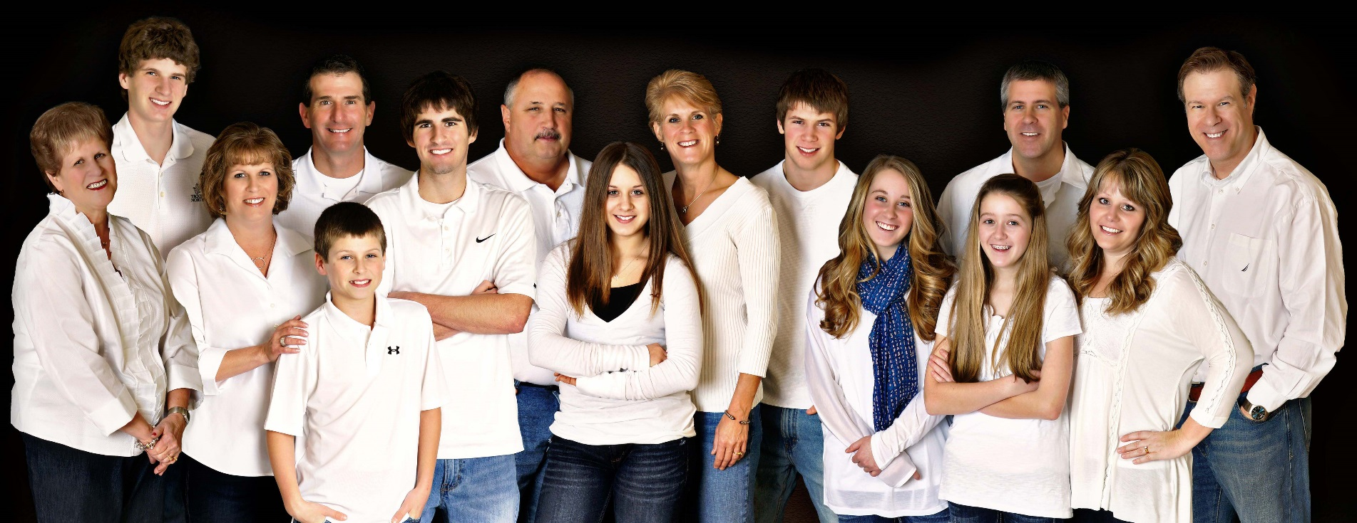
The Perpetual Virginity of Mary
How could Mary have been a perpetual virgin since the Bible clearly states that Jesus had brothers and sisters?
Notes:
The common objection to Mary’s perpetual virginity is the frequent mention of the brothers and sisters of Jesus.

Slide 13
The Perpetual Virginity of Mary
“³ Is he not the carpenter, the son of Mary, and the brother of James and Joses and Judas and Simon? And are not his sisters here with us?” Mark 6:3
Notes:
Here is a prime example of how biblical interpretation must rely not only on what you directly read from your particular translation, but also on the history, culture and use of language at the time of its writing.
To understand this, let’s take a look at some Old Testament passages:

Slide 14
The Perpetual Virginity of Mary
²⁷ These are the descendants of Terah. Terah begot Abram, Nahor, and Haran, and Haran begot Lot.
Genesis 11:27
So. Tarah had three boys, Abram, Nahor and Haran, and Haran had a son named Lot, which makes Lot, Abram’s nephew.
Got it?
Notes:
Here is a prime example of how biblical interpretation must rely not only on what you directly read from your particular translation, but also on the history, culture and use of language at the time of its writing.
To understand this, let’s take a look at some Old Testament passages:

Slide 15
The Perpetual Virginity of Mary
¹² They took with them Abram’s brother Lot, who had been living in Sodom, as well as his possessions, and departed. ¹³ A survivor came and brought the news to Abram the Hebrew, who was camping at the oak of Mamre the Amorite, a kinsman of Eshcol and Aner; these were allies of Abram. ¹⁴ When Abram heard that his brother had been captured, he mustered three hundred and eighteen of his retainers, born in his house, and went in pursuit as far as Dan.
Genesis 14:12-14
Notes:
So suddenly, within just a few passages, Lot becomes Abram’s brother, not his nephew.

Slide 16
The Perpetual Virginity of Mary
Interpreting with the knowledge of the ancient languages.
There were no words for aunts, uncles, nieces, nephews or cousins.
אח : or awkh described all male relatives and is translated as brother.
אחות: or achoth described all female relatives and is translated as sister.
Notes:
Is this a contradiction, or inaccuracy in the scriptures? No, here is the problem: in the ancient languages of the Middle East, the Hebrew word אח or awkh was the only word used to describe male relatives. Every male in your immediate extended family was your brother. Likewise the word for sister was אחות or achoth and
In some translations, in Genesis 14:12, brother has been replace with nephew, and in verse 14 with kinsman, because even though the original word used was awkh or brother we know from chapter 11:27 that Lot is clearly the son of Abrams actual brother Haran, or Abrams nephew.
was used to describe all female relatives within your close extended family. There were no words to describe cousin, aunt, uncle, niece or nephew.

Slide 17
The Perpetual Virginity of Mary
At the Crucifixion
⁵⁵ There were many women there, looking on from a distance, who had followed Jesus from Galilee, ministering to him. ⁵⁶ Among them were Mary Magdalene and Mary the mother of James and Joses, and the mother of the sons of Zebedee.
Matthew 27:55-56
Notes:
This clarifies that in Mark 6:3, that James and Joses were NOT actual brothers of Jesus since they are the sons of another Mary. We know that Mary the mother of Jesus was at the foot of the cross of Jesus, and was not looking on from a distance with the other women.
That the Bible labels them as His brothers, most likely indicates that they were His cousins. Relatives of either Mary’s side or Josephs side of the extended family.

Slide 18
The Perpetual Virginity of Mary
At the Crucifixion
²⁶ When Jesus saw his mother and the disciple there whom he loved, he said to his mother, “Woman, behold, your son.” ²⁷ Then he said to the disciple, “Behold, your mother.” And from that hour the disciple took her into his home.
John 19:26-27
If Jesus had actual brothers, would His last act in life be to grievously offend them?
Notes:
Jewish tradition at this time was that upon the death of the Father, the eldest son took over the responsibility of the care and keeping of the mother. Jesus, clearly hands this honor to his disciple who is not even a kinsman. If he had indeed had many brothers and sisters, this action would have been a grievous insult to his own brothers.

Slide 19
The Perpetual Virginity of Mary
After the Resurrection and Assumption
¹³ When they entered the city they went to the upper room where they were staying, Peter and John and James and Andrew, Philip and Thomas, Bartholomew and Matthew, James son of Alphaeus, Simon the Zealot, and Judas son of James. ¹⁴ All these devoted themselves with one accord to prayer, together with some women, and Mary the mother of Jesus, and his brothers. ¹⁵ During those days Peter stood up in the midst of the brothers (there was a group of about one hundred and twenty persons in the one place)…
Acts 1:14-15
Notes:
Jewish tradition at this time was that upon the death of the Father, the eldest son took over the responsibility of the care and keeping of the mother. Jesus, clearly hands this honor to his disciple who is not even a kinsman. If he had indeed had many brothers and sisters, this action would have been a grievous insult to his own brothers.

Slide 20
The Perpetual Virginity of Mary
After the Resurrection and Assumption
Persons in the room (120)
Eleven apostles plus Judas bar James (12)
Some women, Mary (1) the Mother of Jesus and his brothers
We know of three women, say half a dozen more (9)
…and his brothers (98)
There is no mention of sisters
It is 33 years since the birth of Christ…
Can we do the math?
Notes:
So, there were the eleven remaining Apostles, Judas the son of James, some women, Mary the mother of Jesus and his brothers. Let’s assume that “Some” women were the three mentioned earlier, but we can throw in maybe a half dozen more just for argument’s sake, that makes about twenty two people clearly not His brothers. No mention is made of sisters so that leaves around ninety eight brothers in the room. In the literalist sense, Mary could clearly not have been a perpetual virgin since the birth of ninety eight brothers (not counting sisters) would have necessitated the delivery of one set of triplets every year since the birth of Jesus with one year off when she might have had twins.

Slide 21
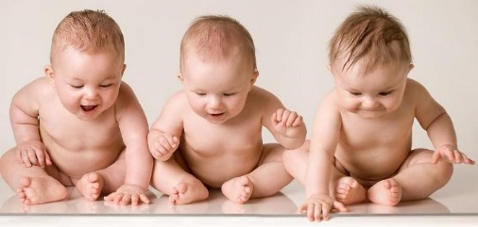
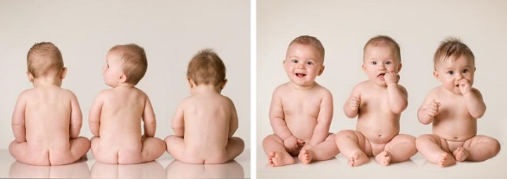
The Perpetual Virginity of Mary
After the Resurrection and Assumption
Far from being a perpetual virgin, Mary would have been in perpetual labor, having given birth to 98 brothers (no mention of sisters) would have meant a set of triplets every year since Christmas, with one year off to have twins.
Notes:
So, there were the eleven remaining Apostles, Judas the son of James, some women, Mary the mother of Jesus and his brothers. Let’s assume that “Some” women were the three mentioned earlier, but we can throw in maybe a half dozen more just for argument’s sake, that makes about twenty two people clearly not His brothers. No mention is made of sisters so that leaves around ninety eight brothers in the room. In the literalist sense, Mary could clearly not have been a perpetual virgin since the birth of ninety eight brothers (not counting sisters) would have necessitated the delivery of one set of triplets every year since the birth of Jesus with one year off when she might have had twins.

Slide 22
The Perpetual Virginity of Mary
The obvious conclusion:
Jesus had no actual brothers or sisters, the scripture having been translated from the ancient languages. There is nothing in the scriptures that can contradict the theology of Mary as ever-virgin

Slide 23
The Perpetual Virginity of Mary
The Catechism of the Catholic Church
The deepening of faith in the virginal motherhood led the Church to confess Mary’s real and perpetual virginity even in the act of giving birth to the Son of God made man. In fact, Christ’s birth “did not diminish his mother’s virginal integrity but sanctified it.” And so the liturgy of the Church celebrates Mary as Aeiparthenos, the “Ever–virgin.” (CCC499)
Notes:
Several additional paragraphs are listed in your handouts.

Slide 24
The Immaculate Conception
The Immaculate Conception
is about Mary
Not Jesus
Notes:
First, let’s clarify what Immaculate Conception is about. It is a common misconception among non-Catholics that it is about Jesus, and even some Catholics believe this. Certainly His conception was immaculate and without sin as must be since He is of God, in God and is God himself, one with the trinity.
But the Church has established the dogma that Mary also was born without original sin. “That Jesus saved her even from the taint of original sin at the moment of her creation.” And she remained sinless throughout her lifetime.

Slide 25
The Immaculate Conception
Common Objection:
“The Immaculate Conception is clearly not scriptural.”
(Where is THAT in the Bible?)
Notes:
So where is that in the Bible

Slide 26
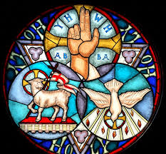
The Immaculate Conception
You might ask:
“Where is the Trinity in the Bible?”
Nearly every Christian will confess believing in it. You have then established that there are Christian concepts NOT specifically spelled out in the Bible
Notes:
When speaking to a non-Catholic about questions such as these we can turn to the original idea of Sola Scriptura, that everything Christian must be found in the Bible. Ask a simple question. “Do you believe in the Trinity?” for 99% of Christians the answer will be “Yes.” Then ask them where the word trinity appears in the Bible. You have very simply confirmed that NOT all Christian concepts are found directly in the Bible.

Slide 27
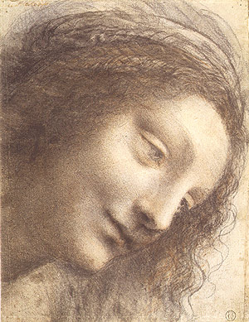
The Immaculate Conception
You might then ask:
“Could God have created Mary without sin if He wanted to?”
Notes:
Then your next question could logically be, “Could God have created Mary without sin if He wanted to?”

Slide 28
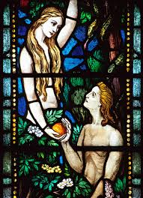
The Immaculate Conception
Did God create any other people without sin? Besides Jesus of course, there are two other documented Biblical Characters created without sin.
Adam and Eve, the first parents, both created without sin, but whose personal sin established original sin for all mankind.
Notes:
First, are there biblical references of anyone else who was sinless? Of course, the very first mother, Eve was created perfect and without sin. It was her personal sin that established the concept of original sin. But before that, she was completely without sin. This establishes that God could and did create human beings without sin.

Slide 29
The Immaculate Conception
Who is greater?
Eve, the instrument through which sin came into the world?
Or Mary, the instrument through which salvation came into the world?
Notes:
If he created Eve without sin, couldn’t he have done the same for Mary? And who was greater in the grand scheme of things? Eve, born without sin was the instrument through which sin came into the world, Mary, was the instrument through which salvation came into the world. Should she not have been born without sin also?

Slide 30
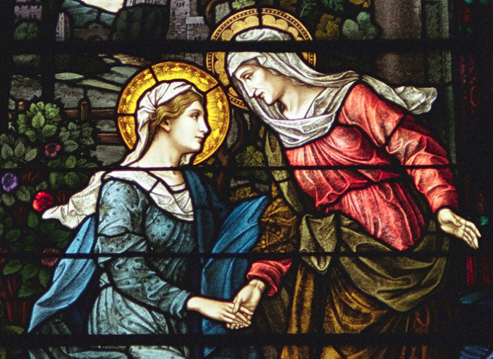
The Immaculate Conception
⁴¹ When Elizabeth heard Mary’s greeting, the infant leaped in her womb, and Elizabeth, filled with the holy Spirit, ⁴² cried out in a loud voice and said, “Most blessed are you among women, and blessed is the fruit of your womb.
Luke 1:41-42
Notes:
Mary is referred to by Elizabeth as “Blessed among women” and Elizabeth was “filled with the Holy Spirit” when she spoke these words. If one is filled with the Holy Spirit, there is no room for error, Mary was blessed among all women. And she replies to Elizabeth:

Slide 31
The Immaculate Conception
⁴⁸ For he has looked upon his handmaid’s lowliness; behold, from now on all generations will call me blessed.
Luke 1:41-42
Notes:
And she replies to Elizabeth: For he has looked upon his handmaid’s lowliness; behold, from now on all generations will call me blessed.
We do not call Eve blessed, and she was created without sin, why then, not Mary?

Slide 32
The Immaculate Conception
Meanwhile, back in the Garden:
¹⁴ Then the LORD God said to the snake: Because you have done this, cursed are you among all the animals, tame or wild; On your belly you shall crawl, and dust you shall eat all the days of your life. ¹⁵ I will put enmity between you and the woman, and between your seed and hers; He will strike at your head, while you strike at his heel.
Geneses 3:14-15
Notes:
This is a clear reference to Jesus Christ conquering Satin. It is known as the Protoevangelium “The First Good News”
Also note this: “…you and the woman, and between your seed and hers;”
This is the only place in scripture that mentions the woman’s seed. All other references to seed, heirs, children, or offspring are from the man. Even the genealogy of Christ in the first chapter of Matthew leads from Abraham through forty two generations to Joseph, not Mary, but in Geneses, the very first mention of any seed of progeny in the Bible is of the woman’s seed, the seed of Mary. Because Mary conceived Jesus of the Holy Spirit, not of a man.
God himself said “…I will put enmity between you and the woman…” which is to say “you and the woman will be enemies.” So if Mary is an enemy of Satin, decreed by God, how can she sin, unless she succumbs to Satin and becomes his ally? Mary MUST have been without sin.

Slide 33
The Immaculate Conception
But in Romans 3:9-12 it clearly states:
⁹ Well, then, are we better off? Not entirely, for we have already brought the charge against Jews and Greeks alike that they are all under the domination of sin,¹⁰ as it is written: “There is no one just, not one, ¹¹ there is no one who understands, there is no one who seeks God. ¹² All have gone astray; all alike are worthless; there is not one who does good, [there is not] even one.
Also Romans 3:23
²³ all have sinned and are deprived of the glory of God.
Notes:
So based on these two passages, Mary MUST have sinned, since ALL have sinned.
Once again, to fully understand any passage we need to look at the WHOLE Bible. Note that Paul says “as it is written”. He is clearly quoting scripture, the only scripture at the time being the Old Testament. Too bad it doesn’t say “as it is written in Psalm 14…”
This is a very important Catholic concept. When someone in the New Testament quotes from the Old Testament, we MUST go back to the Old Testament text to see what it means in context. If we don’t, we are seriously in jeopardy of misunderstanding or misinterpreting the New Testament text.

Slide 34
The Immaculate Conception
¹ The fool says in his heart, “There is no God.” Their deeds are loathsome and corrupt; not one does what is good. ² The LORD looks down from heaven upon the children of men, to see if even one is wise, if even one seeks God. ³ All have gone astray; all alike are perverse. Not one does what is good, not even one. ⁴ Will these evildoers never learn? They devour my people as they devour bread; they do not call upon the LORD. ⁵ They have good reason, then, to fear; God is with the company of the just.
Psalm 14:1-3
Notes:
This is an extremely important lesson for us to remember. There are powerful references to the Old Testament from the New Testament but if we fail to look at them in their full context we will almost surely misinterpret the meaning of the New Testament passages.
Therefore, when Paul says in Romans “as it is written: … …there is not one who does good, [there is not] even one.” We MUST look back at what he is quoting to understand the context. Out of context the passage seems to say that no man on earth does good or is without sin. But the passage he is quoting from in Psalm 14: clearly is NOT talking about every man on earth, but specifically about the evildoers who turn away from God.
Clearly, David is speaking of two groups of people, the evildoers and the just.
With the Old Testament context, we can see that Paul is talking about the burden of original sin from which we all suffer. And this clearly leaves the possibility that there are some who do not suffer personal sin.

Slide 35
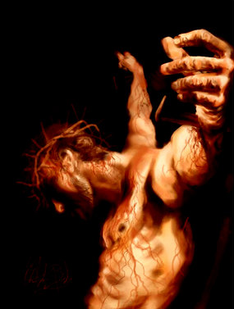
The Immaculate Conception
Another prime example of this are some of the last words of Christ on the cross:
“My God, my God, why have you forgotten me?”
Notes:
What did Christ mean when he called these words out to God? Or was it to the crowd gathered around the cross?

Slide 36
The Immaculate Conception
“Oh say can you see,
By the dawn’s early light…”
Notes:
What do you feel when I show you this slide?
A touch of patriotism perhaps?
What do you know?
The rest of the song.
Because in our current society, our surroundings, our constant reminders of certain things you know instinctively what this song is about and what the rest of the words are without hesitation.

Slide 37
The Immaculate Conception
At the time of the crucifixion, every good Jew around the cross had that same reaction to the words:
“My God, my God, why have you forgotten me?”
The opening stanza of Psalm 22
Notes:
At the time of the crucifixion, every good Jew around the cross had that same reaction to the words: “My God, my God, why have you forgotten me?” The opening stanza of Psalm 22

Slide 38
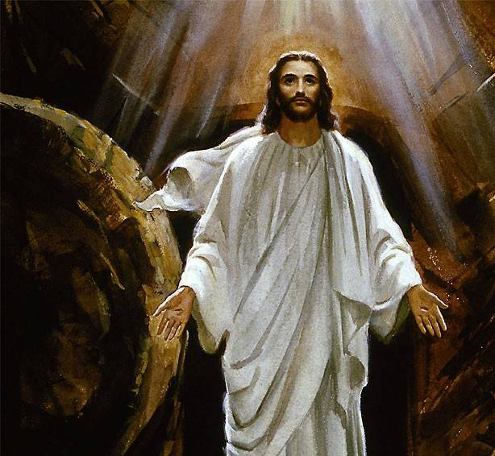
The Immaculate Conception
They all knew that the closing stanzas of the psalm were all about the good to come:
³¹ The generation to come will be told of the Lord, that they may proclaim to a people yet unborn the deliverance you have brought.
Notes:
They all knew that the closing stanzas of the psalm were all about the good to come:
³¹ The generation to come will be told of the Lord, that they may proclaim to a people yet unborn the deliverance you have brought.

Slide 39
The Immaculate Conception
Are there others in scripture without sin?
The company of the Just from Psalm 14
Zechariah and Elizabeth:
“Both were righteous in the eyes of God, observing all the commandments and ordinances of the Lord blamelessly”
Their son John:
“He will be filled with the Holy Spirit even from his mother’s womb.”
Notes:
What about other blameless, sinless people in the Bible?
The company of the Just, from back in Psalm 14
Zechariah and Elizabeth… were righteous in the eyes of God, observing all the commandments and ordinances of the Lord blamelessly”
John the Baptist… will be filled with the Holy Spirit even from his mother’s womb

Slide 40
The Immaculate Conception
⁵ By faith Enoch was taken up so that he should not see death, and “he was found no more because God had taken him.” Before he was taken up, he was attested to have pleased God.
Hebrew 11:5
¹¹ As they walked on still conversing, a fiery chariot and fiery horses came between the two of them, and Elijah went up to heaven in a whirlwind,
2 Kings 2:11
Notes:
Enoch and Elijah.
You don’t get into heaven with sin on your soul.

Slide 41
The Immaculate Conception
³ They were singing [what seemed to be] a new hymn before the throne, before the four living creatures and the elders. No one could learn this hymn except the hundred and forty-four thousand who had been ransomed from the earth. ⁴ These are they who were not defiled with women; they are virgin and these are the ones who follow the Lamb wherever he goes. They have been ransomed as the first fruits of the human race for God and the Lamb. ⁵ On their lips no deceit has been found; they are unblemished.
One hundred forty four thousand sinless souls!
Revelation 14:3-5
Notes:
The one hundred forty four thousand…

Slide 42
The Immaculate Conception
The Catechism of the Catholic Church
Through the centuries the Church has become ever more aware that Mary, “full of grace” through God, (Lk 1:28) was redeemed from the moment of her conception. That is what the dogma of the Immaculate Conception confesses, as Pope Pius IX proclaimed in 1854: (411)
(CCC 491)
The most Blessed Virgin Mary was, from the first moment of her conception, by a singular grace and privilege of almighty God and by virtue of the merits of Jesus Christ, Savior of the human race, preserved immune from all stain of original sin. (Pius IX, Ineffabilis Deus, 1854: DS 2803)
Notes:
The Catechism of the Catholic Church

Slide 43
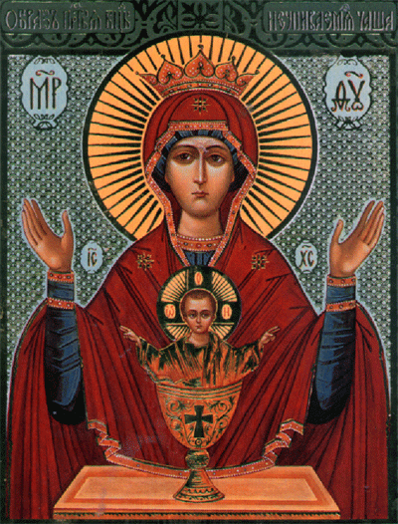
The Immaculate Conception
Next session, Mary:
The assumption of…
As Ark of the New Covenant
As Queen of Heaven
Notes:
Next session:
The Assumption of Mary
Mary as ark of the new covenant
Mary as Queen of Heaven

Slide 44
Apologetics… Defending the Faith
Scripture in Support of Our Catholic Beliefs

